Slide 1
DPM Meeting 2
Design Ideas and Tests

Slide 2
Gantt Chart

Slide 3
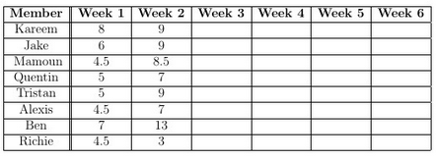
Budget
Week 2:
Kareem
Hardware tests (Brick Communication)
System Diagram
Management docs
Jake
Converted Week 1 docs to LaTeX
Created design doc templates
Assisted with hardware tests
Tristan & Alexis:
API Research
System Diagram
Class diagram
Mamoun & Richie:
Hardware tests (Treads vs wheels)
Quentin & Ben:
Hardware design (Collection Mechanisms)
Sketches

Slide 4
Hardware Design
Grabbers
Lifters
Collectors
Grabber/Lifter/Collector Hybrids
Multiple Bricks
Using one or more bricks to control everything
Locomotion
Wheel versus Treads

Slide 5
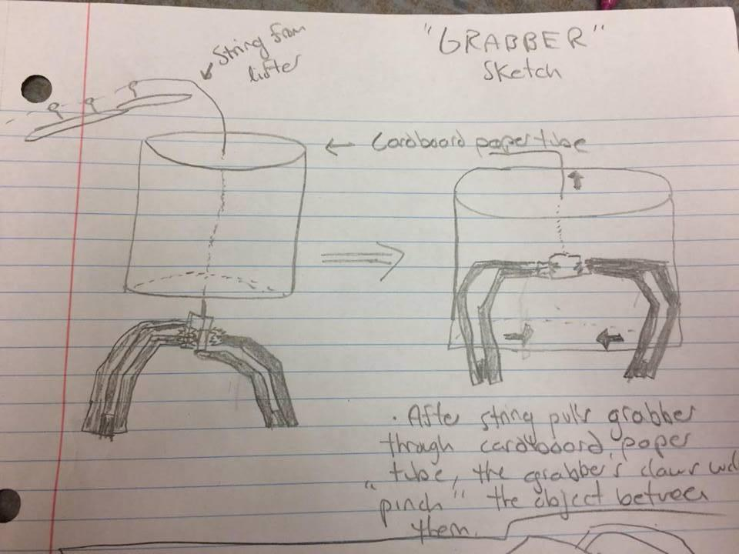
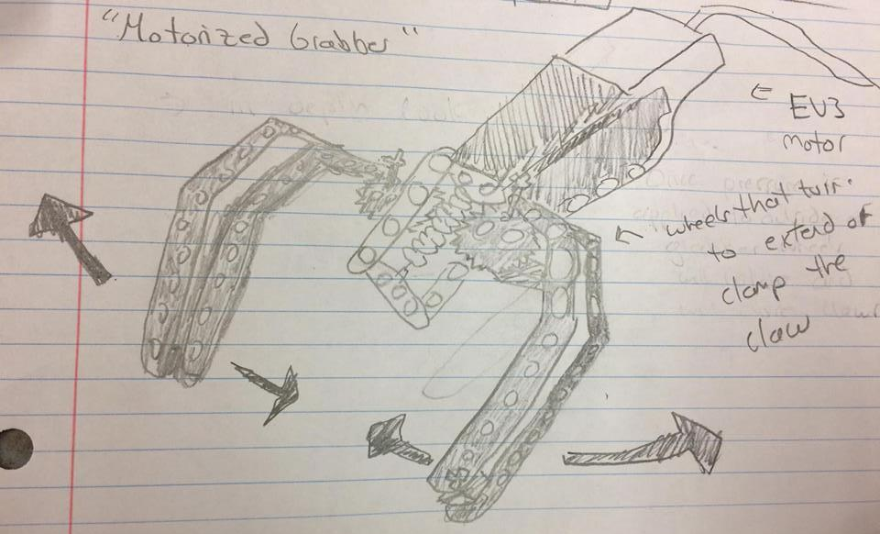
Grabbers

Slide 6
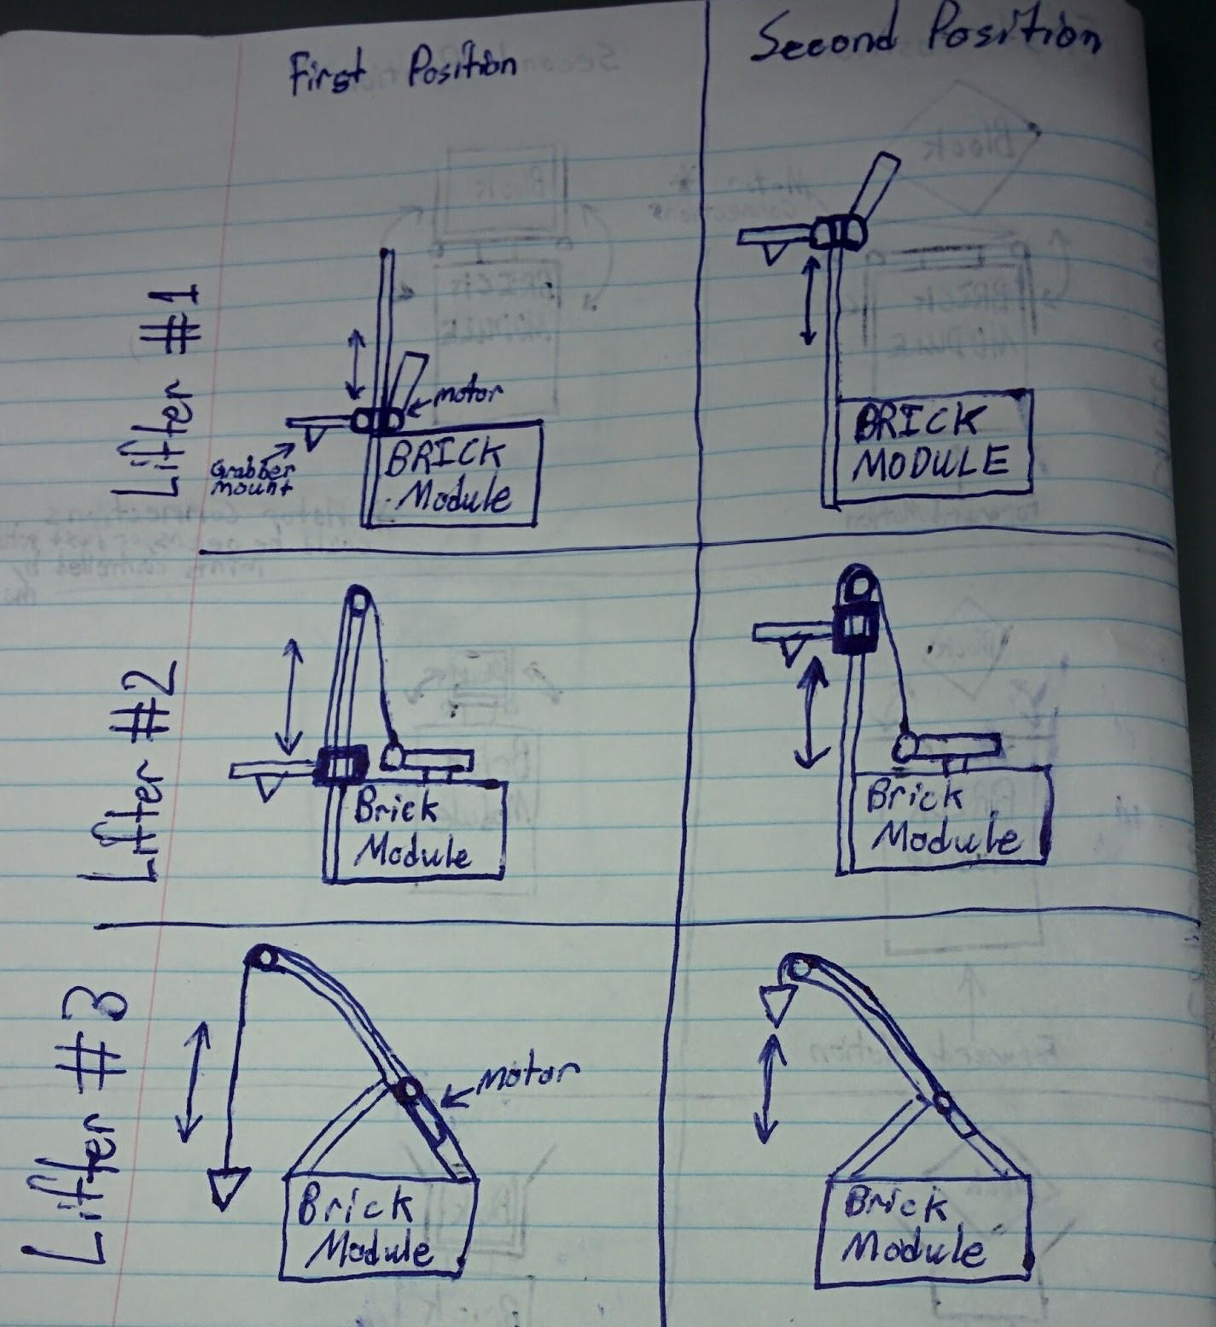
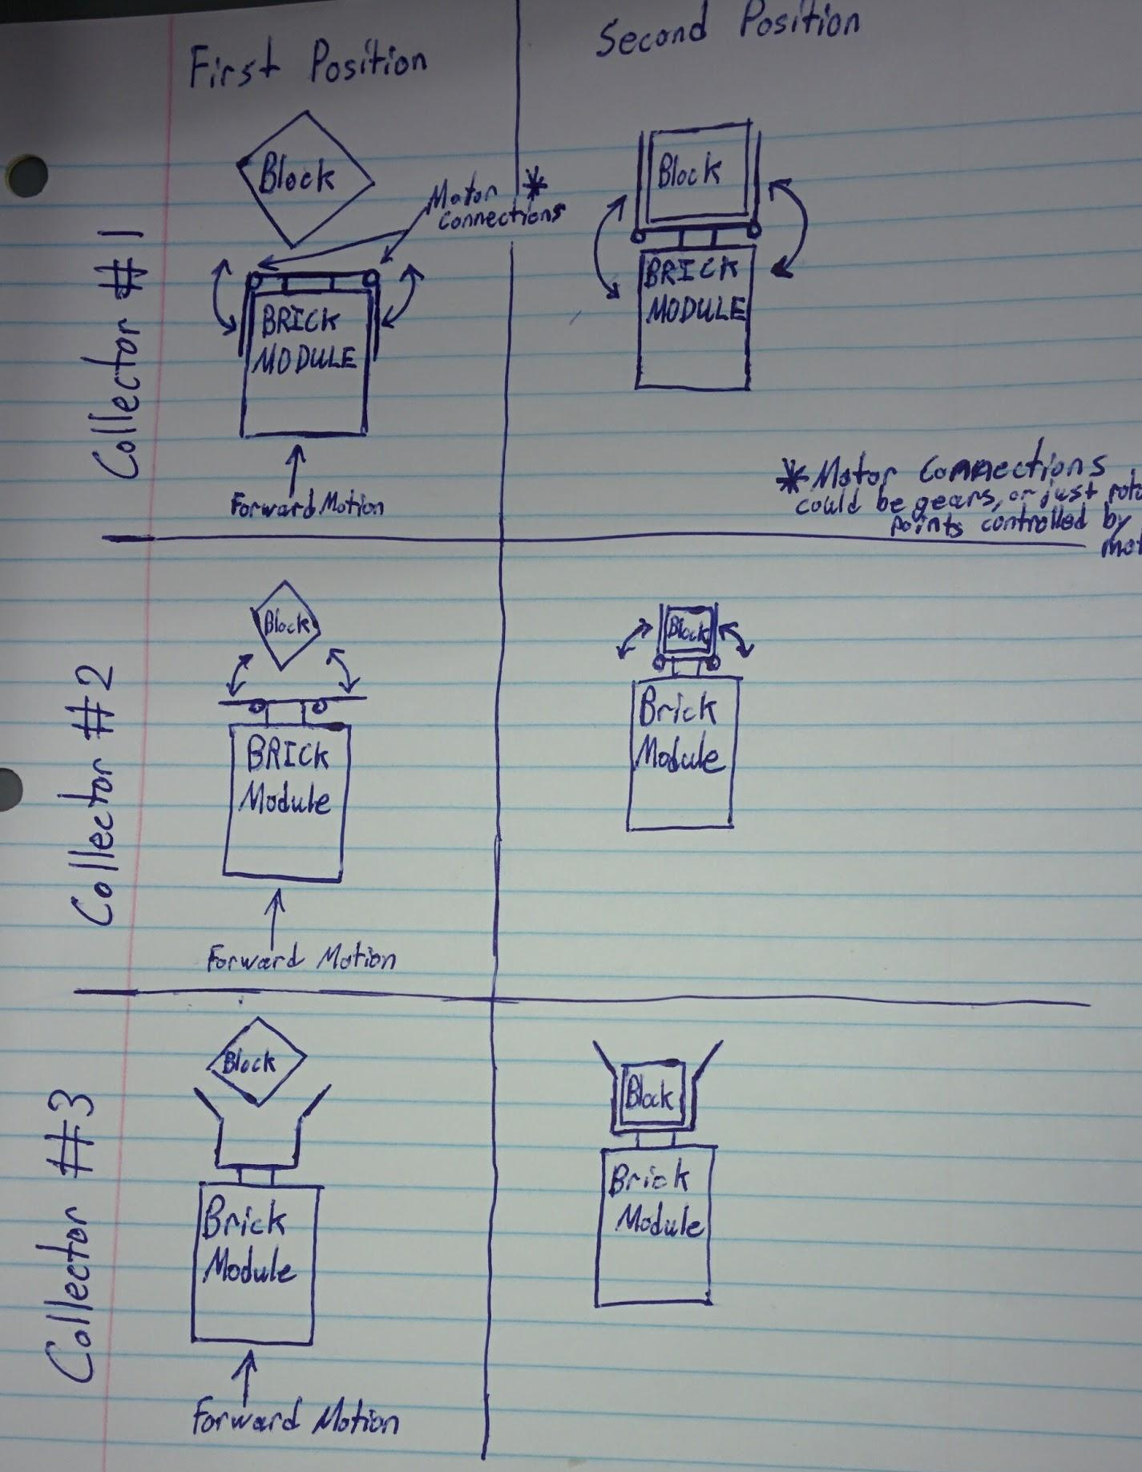
Lifters and Collectors

Slide 7
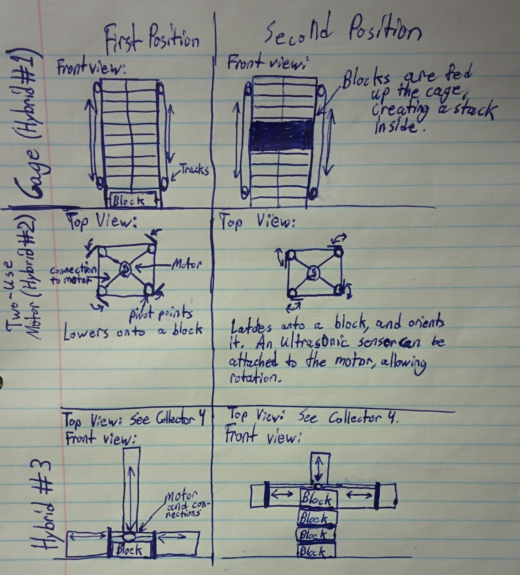
Hybrids

Slide 8
Software Design
API Research
Flowchart
Class Hierarchy

Slide 9
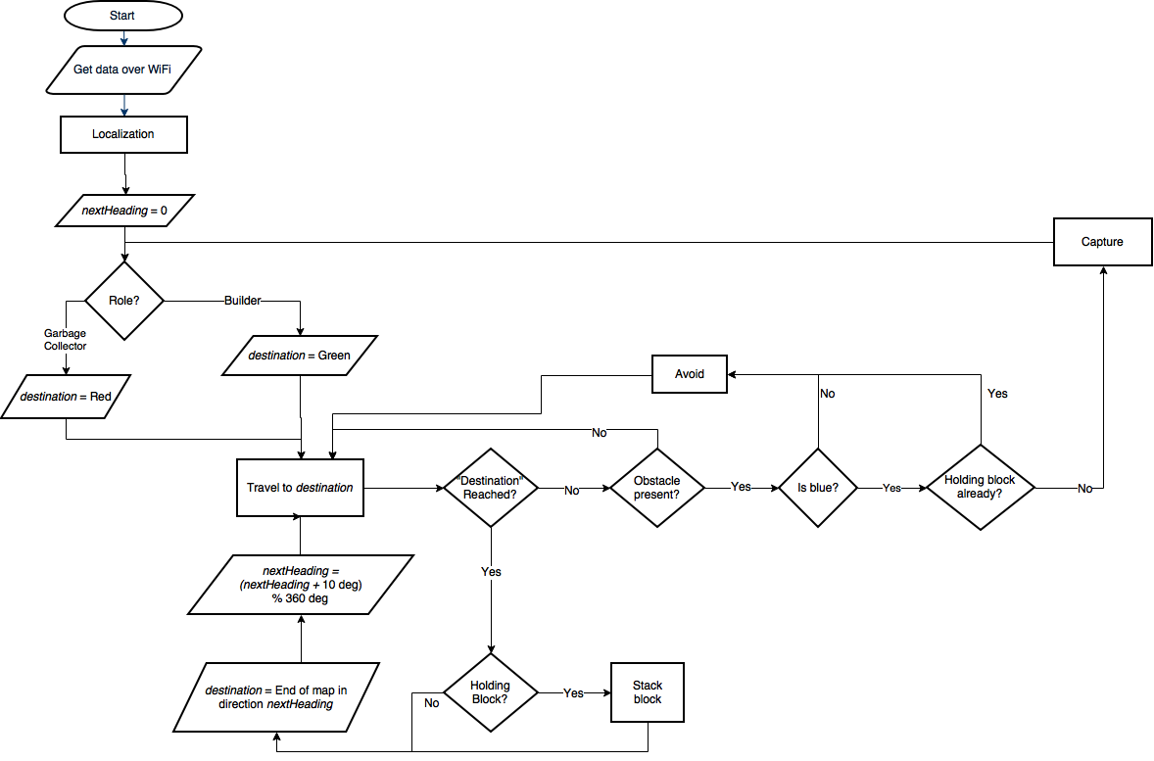
Flowchart

Slide 10
Class Diagram

Slide 11
Testing
Multiple Bricks
Is there an issue communicating between the two bricks?
Not evidently: 3 threads at once polling 6 sensors whose values change the speed of 6 motors
Treads versus Wheels
Which one will not get stuck between the discontinuities?
Ball at back of wheels gets stuck if not travelling perpendicular to discontinuity
Some issues with odometry accuracy on treads
Multiple ultrasonic sensors
Is there interference when two sensors poll in parallel?
Not if they are placed perpendicular to each other

Slide 12
Connection to Lab 5
Lab 5 is a subset of the project algorithm involving
Localization
Navigation
Object search and detection
Object identification
Collision avoidance
Block capture
However, the project is far more challenging!

